Slide 1
Chapter 8:
Sampling, Standardization, and Calibration

Slide 2
A chemical analysis uses only a small fraction of the available sample, the process of sampling is a very important operation.
Knowing how much sample to collect and how to further subdivide the collected sample to obtain a laboratory sample is vital in the analytical process.
Statistical methods are used to aid in the selection of a representative sample.

Slide 3
A chemical analysis uses only a small fraction of the available sample, the process of sampling is a very important operation.
Knowing how much sample to collect and how to further subdivide the collected sample to obtain a laboratory sample is vital in the analytical process.
Statistical methods are used to aid in the selection of a representative sample.

Slide 4
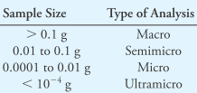
8A Analytical Samples and Methods
Types of Samples and Methods
Quantitative methods are traditionally classified as gravimetric methods, volumetric methods, or instrumental methods.
Other methods are based on the size of the sample and the level of the constituents.
Sample Size
Techniques for handling very small samples are quite different from those for treating macro samples.
辨識化學物種的方法——定性分析方法(qualitative analysis)，和量測出組成分數量的方法——定量分析方法 (quantitative analysis)。

Slide 5
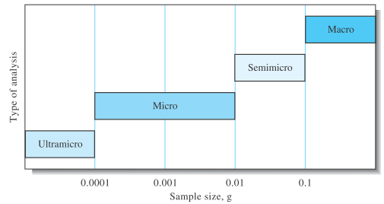
Figure 8-1 Classification of analyses by sample size.
樣品數量
  大量分析法 (macro analysis) 一詞是指，所使用的樣品質量超過 0.1 g。
  使用之樣品數量在0.01 到 0.l g 範圍之間的方法稱為是半微量分析法 (semimicro analysis) 。
  微量分析法 (micro analysis) 所使用的樣品數量在 10⁻⁴到 10⁻² g 之間。
  樣品質量低於 10⁻⁴ g 時，有時會使用超微量分析法 (ultramicro analysis) 來分析之。

Slide 6
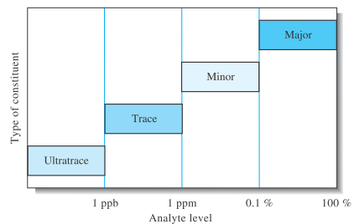
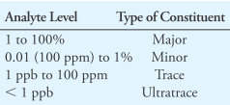
Figure 8-2 Classification of constituent types by analyte level.

Slide 7
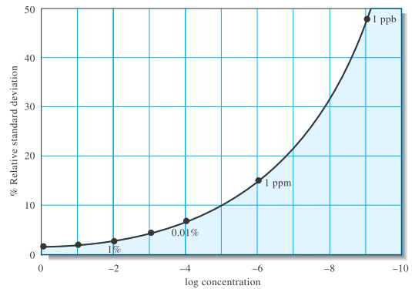
A general problem in trace procedures is that the reliability of results usually decreases dramatically with a decrease in analyte level.
The relative standard deviation between laboratories increases as the level of analyte decreases.
At the ultratrace level of 1 ppb, interlaboratory error (%RSD) is nearly 50%. At lower levels, the error approaches 100%.
Figure 8-3 Interlaboratory error as a function of analyte concentration.

Slide 8
Real Samples
The analysis of real samples is complicated by the presence of the sample matrix.
The matrix can contain species with chemical properties similar to the analyte.
If the interferences are caused by extraneous species in the matrix, they are often called matrix effects.
Such effects can be induced not only by the sample itself but also by the reagents and solvents used to prepare the samples for the determination.

Slide 9
樣品是被分析的，但是物種或者濃度值則是被量測的。
因此正確的說法是，血清中的葡萄糖含量測量方法，或者血清樣品中葡萄糖分析方法。

Slide 10
8B Sampling
The process by which a representative fraction is acquired from a material of interest is termed sampling.
Sampling for a chemical analysis necessarily requires the use of statistics because conclusions will be drawn about a much larger amount of material from the analysis of a small laboratory sample.
Obtaining a Representative Sample
The items chosen for analysis are often called sampling units or sampling increments.
The collection of sampling units or increments is called the gross sample.
For laboratory analysis, the gross sample is usually reduced in size and homogenized to create the laboratory sample.
The composition of the gross sample and the laboratory sample must closely resemble the average composition of the total mass of material to be analyzed.
在取樣過程中，會將樣品母體減量至其數量能夠方便在實驗室進行後續處理工作，且其組成仍然可以代表整體的一種均質性物質。

Slide 11
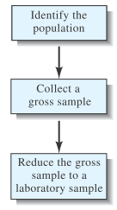
Figure 8-4 Steps in obtaining a laboratory sample.
The laboratory sample consists of a few grams to at most a few hundred grams. It may constitute as little as 1 part in 10⁷ -10⁸ of the bulk material.

Slide 12
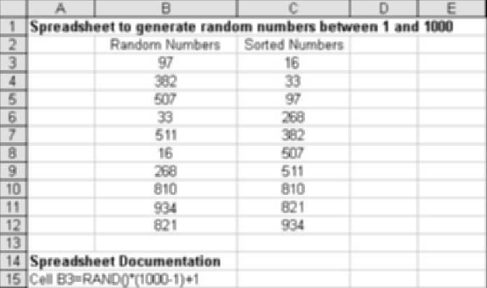
Both goals require obtaining a random sample.
A randomization procedure may be used wherein the samples are assigned a number and then a sample to be tested is selected from a table of random numbers.
Sampling Uncertainties
Figure 8-5 10 random numbers
are generated
from 1 to 1000 using a
spreadsheet. The random
number function in Excel
[=RAND()] generates random
numbers between 0 and 1.

Slide 13
For random and independent uncertainties, the overall standard deviation s_{o} for an analytical measurement is related to the standard deviation of the sampling process s_{s} and to the standard deviation of the method s_{m} by the relationship
s²₀ = s²_{s} + s²_{m}
An analysis of variance can reveal whether the between samples variation (sampling plus measurement variance) is significantly greater than the within samples variation (measurement variance).
When s_{m} ≤ s_{s}/3, there is no point in trying to improve the measurement precision.

Slide 14
Sampling Homogeneous Solutions of Liquids and Gases
Well-mixed solutions of liquids and gases require only a very small sample because they are homogeneous down to the molecular level. Gases can be sampled by several methods.

Slide 15
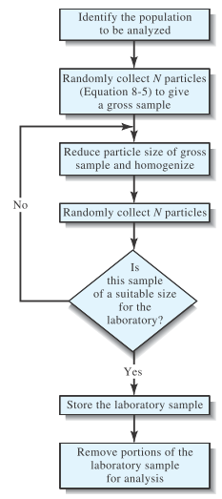
Figure 8-6 Sampling Particulate Solids

Slide 16
Preparing a Laboratory Sample
For heterogeneous solids, the mass of the gross sample may range from hundreds of grams to kilograms or more.
Reduction of the gross sample to a finely ground and homogeneous laboratory sample, of at most a few hundred grams, is necessary.

Slide 17
8 C Automated sample handling
Automated sample handling can lead to higher throughput (more analyses per unit time), higher reliability, and lower costs than manual sample handling.
Discrete Methods
These often mimic the operations that would be performed manually.
Some discrete sample processors automate only the measurement step of the procedure or a few chemical steps and the measurement step.
Continuous Flow Methods
The sample is inserted into a flowing stream where a number of operations can be performed prior to transporting it to a flow-through detector.
These methods can perform not only sample processing operations but also the final measurement step.

Slide 18
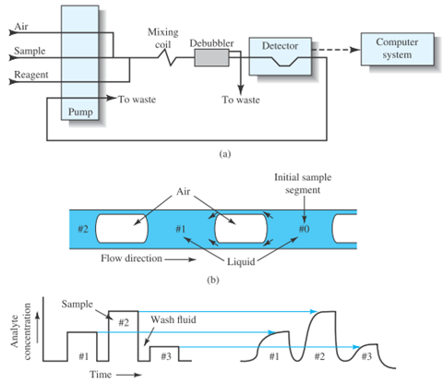
Figure 8-7 Segmented continuous flow analyzer.

Slide 19
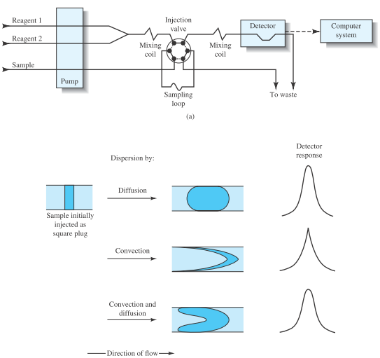
Figure 8-8 Flow injection analyzer. Samples can be processed with FIA at rates varying from 60 to 300 samples per hour.

Slide 20
8D Standardization and calibration
Calibration determines the relationship between the analytical response and the analyte concentration, which is usually determined by the use of chemical standards prepared from purified reagents.
To reduce interferences from other constituents in the sample matrix, called concomitants, standards are added to the analyte solution (internal standard methods or standard addition methods) or matrix matching or modification is done.
Almost all analytical methods require calibration with chemical standards.

Slide 21
Comparison with Standards
Two types of comparison methods are: direct comparison techniques
and titration procedures.
Direct Comparison
Some analytical procedures involve comparing a property of the analyte with standards such that the property being tested matches or
nearly matches that of the standard. This is called null comparison or isomation methods.
Some modern instruments use a variation of this procedure to determine if an analyte concentration exceeds or is less than some threshold level. Such a comparator can be used to determine whether the threshold has been exceeded.

Slide 22
Titrations
Titrations are one of the most accurate of all analytical procedures.
In a titration, the analyte reacts with a standardized reagent (the titrant) in a known stoichiometric manner.
The amount of titrant is varied until chemical equivalence is reached as indicated by the color change of a chemical indicator or by the change in an instrument response. This is called the end point.
The amount of the standardized reagent needed to achieve chemical equivalence can then be related to the amount of analyte present by means of the stoichiometry.
Titration is thus a type of chemical comparison.

Slide 23
External Standard Calibration
A series of standard solutions is prepared separately from the sample.
The standards are used to establish the instrument calibration function, which is obtained from analysis of the instrument response as a function of the known analyte concentration.
The calibration function can be obtained graphically or in mathematical form.
Generally, a plot of instrument response versus known analyte concentrations is used to produce a calibration curve, sometimes called a working curve.

Slide 24
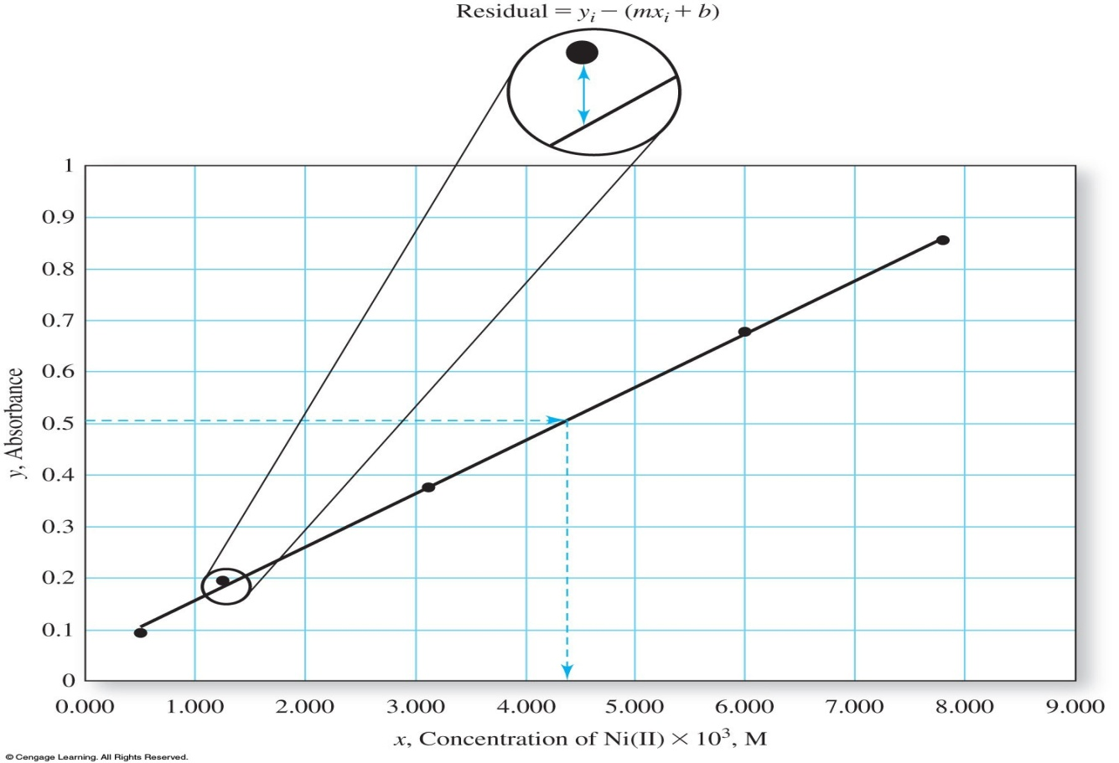
Figure 8-9 Calibration curve of absorbance versus analyte concentration for a series of standards.

Slide 25
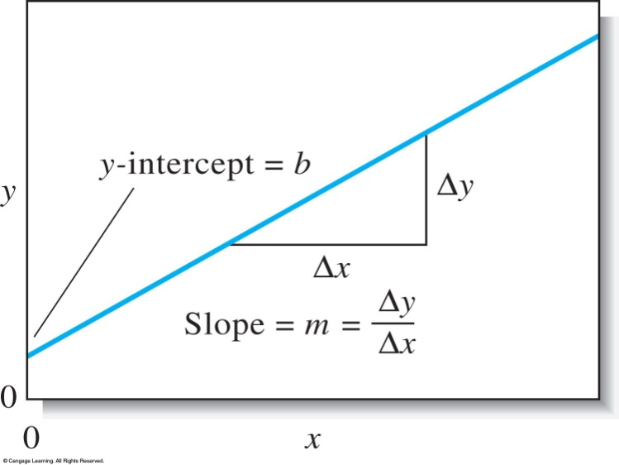
The Least-Squares Method
Statistical methods, such as the method of least squares, are routinely used to find the mathematical equation describing the calibration function.
Two assumptions are made:
  There is actually a linear relationship between the measured response y (absorbance) and the standard analyte concentration x.
  Figure 8-10 The slope-intercept form of a straight line.

Slide 26
  The mathematical relationship that describes this assumption is called the regression model, which may be represented as
  y = mx + b
  where, b is the y intercept (the value of y when x is zero), and m is the slope of the line.
  2. We also assume that any deviation of the individual points from the straight line arises from error in the measurement. That is, we assume there is no error in x values of the points (concentrations).

Slide 27
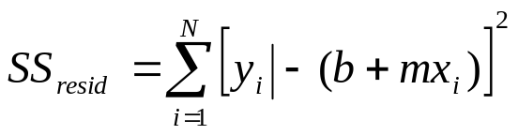
Finding the least-Squares line
The least-squares method finds the sum of the squares of the residuals SS_{resid} and minimizes the sum using calculus.

Slide 28
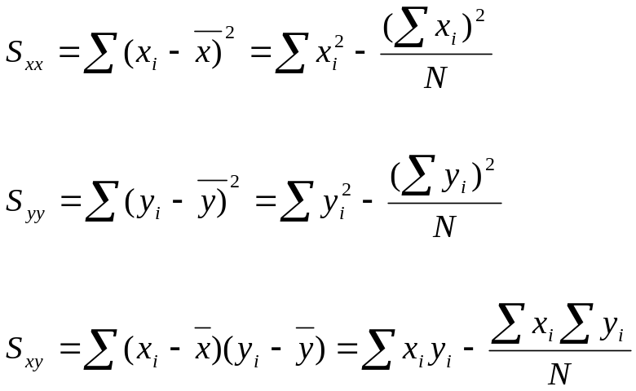
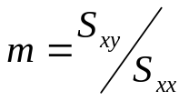

The slope and the intercept are defined as:
where x_{i} and y_{i} are individual pairs of data for x and y, N is the number of pairs, and x and y are the average values for x and y.
From these values, one can derive the
(1) Slope of the line,
(2) Intercept,

Slide 29
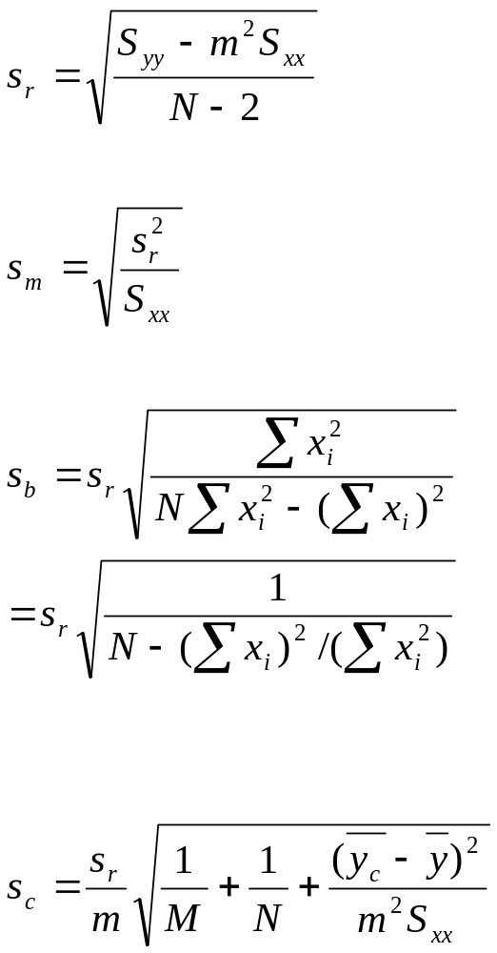
(3) Standard deviation about regression
(4) Standard deviation of the slope
(5) Standard deviation of the intercept
(6) Standard deviation for results obtained from
the calibration curve

Slide 30
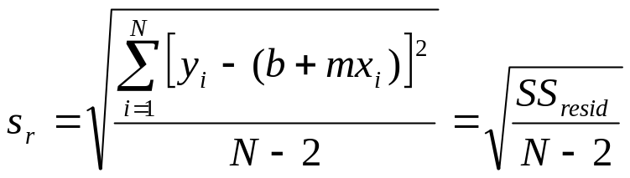
The standard deviation about regression, also called the standard error of the estimate or just the standard error, is a rough measure of the magnitude of a typical deviation from the regression line.

Slide 31
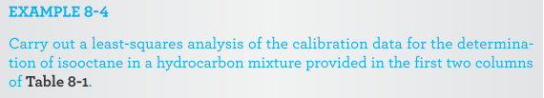
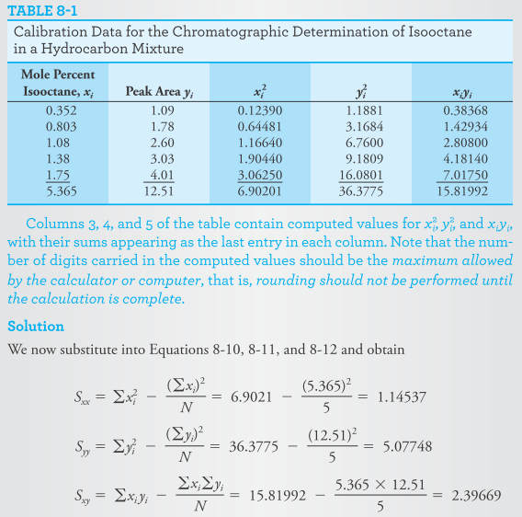

Slide 32
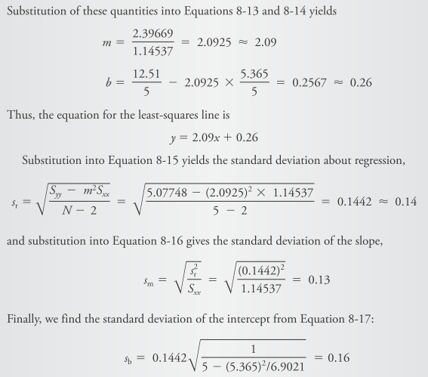

Slide 33
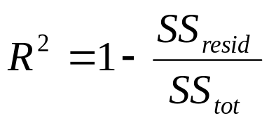
The total sum of the squares is a measure of the total variation in the observed values of y since the deviations are measured from the mean value of y.
The coefficient of determination (R²) measures the fraction of the observed variation in y that is explained by the linear relationship.

Slide 34
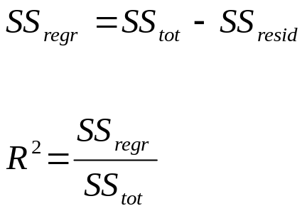
The difference between SS_{tot} and SS_{resid} is the sum of the squares due to regression, SS_{regr}.
A significant regression is one in which the variation in the y values due to the presumed linear relationship is large compared to that due to error (residuals).
The F value gives us an indication of the significance of the regression. When the regression is significant, a large value of F occurs.

Slide 35
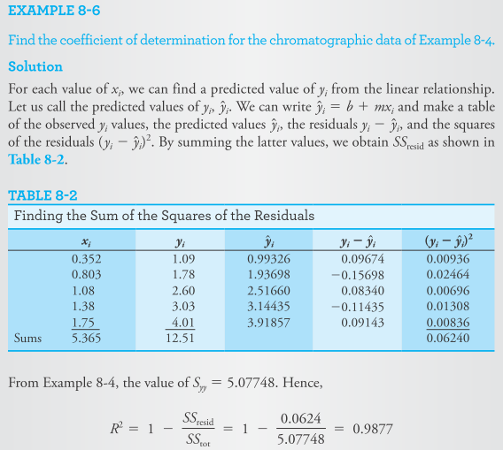
由這個數值顯示出，在峰線面積中有超過 98 % 的變化量是可以使用線性模式來解釋的。

Slide 36
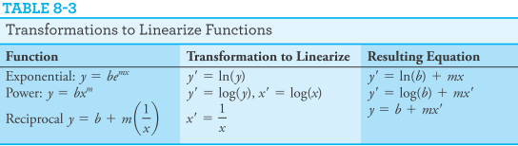
Transformed Variables
Linear least squares gives best estimates of the transformed variables, but these may not be optimal when transformed back to obtain estimates of the original parameters.
For the original parameters, nonlinear regression methods may give better estimates.

Slide 37
Errors in External Standard Calibration
When external standards are used, it is assumed that, when the same analyte concentration is present in the sample and in the standard, the same response will be obtained.
Instead, the raw analytical response is corrected by measuring a blank. The ideal blank is identical to the sample but without the analyte.
A real blank is either a solvent blank, containing the same solvent in which the sample is dissolved, or a reagent blank, containing the solvent plus all the reagents used in sample preparation.

Slide 38
Systematic errors can also occur during the calibration process.
To avoid systematic errors in calibration, standards must be accurately prepared, and their chemical state must be identical to that of the analyte in the sample.
The standards should be stable in concentration, at least during the calibration process.
Random errors can also influence the accuracy of results obtained from calibration curves.

Slide 39
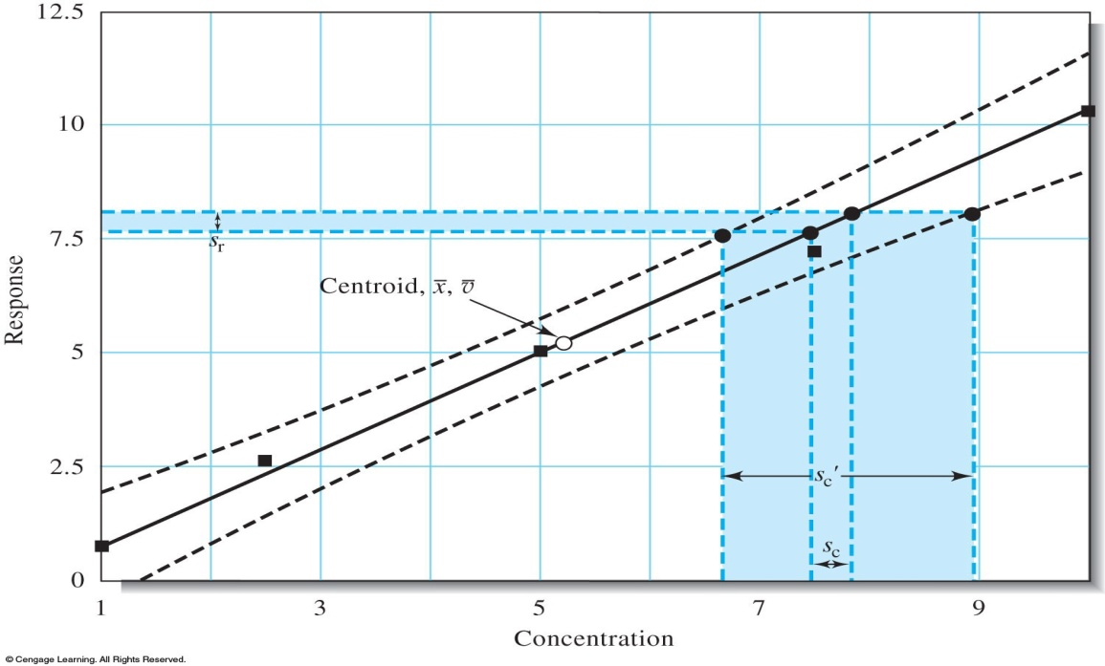
Figure 8-11 Shown here is a calibration curve with confidence limits.
Measurements made near the center of the curve will give less uncertainty in analyte concentration than those made at the extremes.

Slide 40
Minimizing Errors in Analytical Procedures
The overall accuracy and precision of an analysis is not limited to the measurement step and might instead be limited by factors such as sampling, sample preparation, and calibration.
Separations
Sample cleanup by separation methods is an important way to minimize errors from possible interferences in the sample matrix.
Techniques such as filtration, precipitation, dialysis, solvent extraction, volatilization, ion exchange, and chromatography can be used.
In most cases, separations may be the only way to eliminate an interfering specimen.

Slide 41
Saturation, Matrix Modification, and Masking
The saturation method involves adding the interfering species to all the samples, standards, and blanks so that the interference effect becomes independent of the original concentration of the interfering species in the sample.
A matrix modifier is a species, not itself an interfering species, added to samples, standards, and blanks in sufficient amounts to make the analytical response independent of the concentration of the interfering species.
Sometimes, a masking agent is added that reacts selectively with the interfering species to form a complex that does not interfere.

Slide 42
Dilution and Matrix Matching
The dilution method can sometimes be used if the interfering species produces no significant effect below a certain concentration level.
The matrix-matching method attempts to duplicate the sample matrix by adding the major matrix constituents to the standard and blank solutions.

Slide 43
Internal Standard Methods
An internal standard is a reference species, chemically and physically similar to the analyte, that is added to samples, standards, and blanks.
The ratio of the response of the analyte to that of the internal standard is plotted versus the concentration of analyte.
In the internal standard method, a known amount of a reference species is added to all the samples, standards, and blanks.
The response signal is then not the analyte signal itself but the ratio of the analyte signal to the reference species signal.

Slide 44
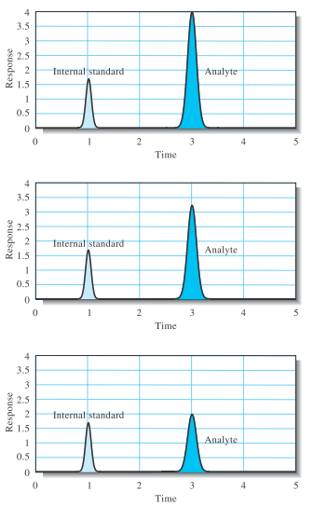
Figure 8-12 Illustration of the internal standard method.

Slide 45
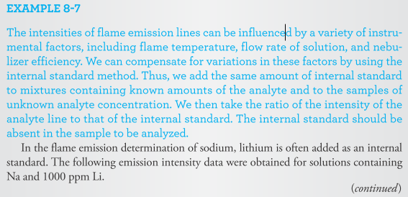
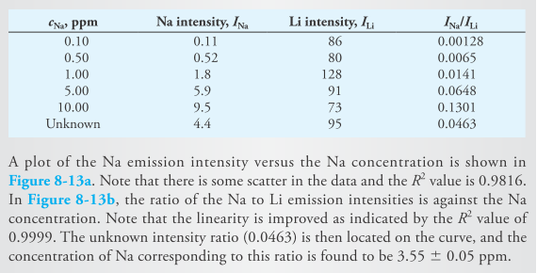

Slide 46
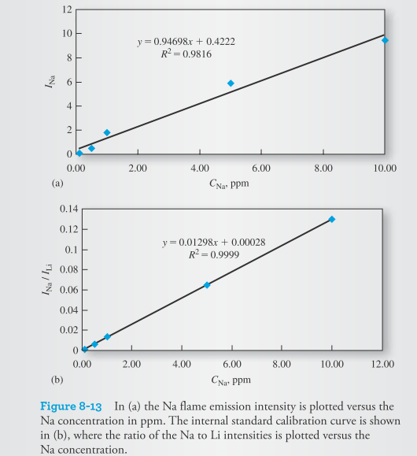

Slide 47
Standard Addition Methods
The method of standard additions is used when it is difficult or impossible to duplicate the sample matrix.
A known amount of a standard solution of analyte is added to one portion of the sample.
Alternatively, multiple additions are made to several portions of the sample.
The method of standard additions is quite powerful so long as there is a good blank measurement so that extraneous species do not contribute to the analytical response.
Second, the calibration curve for the analyte must be linear in the sample matrix.

Slide 48
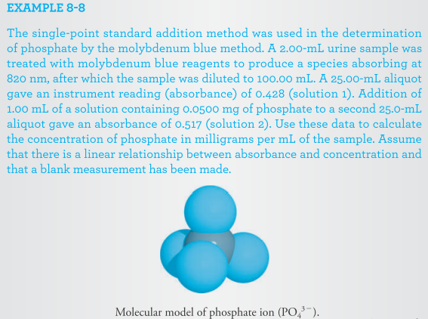

Slide 49
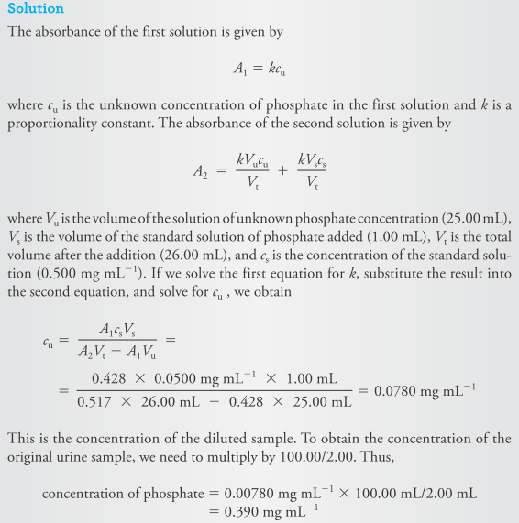

Slide 50
8E Figures of merit for analytical methods
Analytical procedures are characterized by a number of figures of merit such as accuracy, precision, sensitivity, detection limit, and dynamic range.
Sensitivity and Detection Limit
The definition of sensitivity most often used is the calibration sensitivity, or the change in the response signal per unit change in analyte concentration.
The calibration sensitivity is thus the slope of the calibration curve.

Slide 51
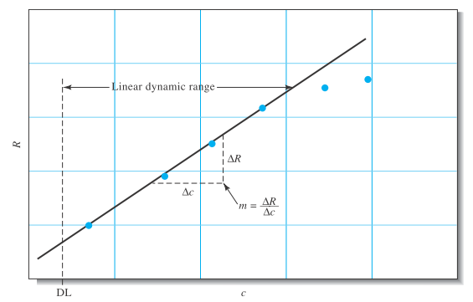
Figure 8-14 Calibration curve of response R versus concentration c.
The slope of the calibration curve is called the calibration sensitivity m.
The detection limit, DL, designates the lowest concentration that can be
measured at a specified confidence level.

Slide 52
The calibration sensitivity does not indicate what concentration differences can be detected.
Instead, the term analytical sensitivity is sometimes used.
The analytical sensitivity is the ratio of the calibration curve slope to the standard deviation of the analytical signal at a given analyte concentration.
The analytical sensitivity is usually a strong function of concentration.

Slide 53
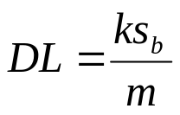
The detection limit, DL, is the smallest concentration that can be reported with a certain level of confidence.
Every analytical technique has a detection limit.
It is the analyte concentration that produces a response equal to k times the standard deviation of the blank sb
where k is called the confidence factor and m is the calibration sensitivity. The factor k is usually chosen to be 2 or 3.
在一般上，可以選擇參數 k 等於 2 或者 3。等於 2 的 k 值相當於是 92.1% 的可信水準，而等於 3 的 k 值相當於 98.3% 的可信水準。

Slide 54
Linear Dynamic Range
The linear dynamic range of an analytical method most often refers to the concentration range over which the analyte can be determined using a linear calibration curve .
The lower limit is generally considered to be the detection limit.
The upper end is usually taken as the concentration at which the analytical signal or the slope of the calibration curve deviates by a specified amount.
Usually a deviation of 5% from linearity is considered the upper limit.

Slide 55
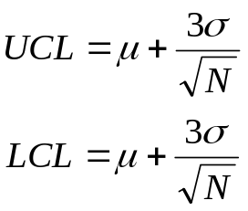
Quality Assurance of Analytical Results
Control Charts
A control chart is a sequential plot of some quality characteristic that is important in quality assurance.
The chart also shows the statistical limits of variation, the upper control limit (UCL) and lower control limit (LCL), that are permissible for the characteristic being measured.
where m is the population mean for the mass measurement, s is the population standard deviation for the measurement, and N is the number of replicates that are obtained for each sample.

Slide 56
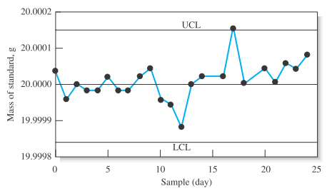
Figure 8-15 A control chart for a modern analytical balance.
As long as the mean mass remains between the LCL and the UCL,
the balance is said to be in statistical control.

Slide 57
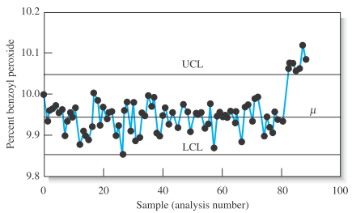
Figure 8-16 A control chart for monitoring the concentration of benzoyl peroxide in a commercial acne preparation.
The manufacturing process became out of statistical control with sample 83 and exhibited a systematic change in the mean concentration.

Slide 58
Validation
Validation determines the suitability of an analysis for providing the sought-for information and can apply to samples, to methodologies, and to data.
Validation is often done by the analyst, but it can also be done by supervisory personnel.
Validation of samples is often used to accept samples as members of the population being studied, to admit samples for measurement, to establish the authenticity of samples, and to allow for resampling if necessary.

Slide 59
Reporting Analytical Results
Analytical results should be reported as the mean value and the standard deviation.
A confidence interval for the mean, the interval and its confidence level should be explicitly reported.
結果報告應該遵循良好實驗室操作 (good laboratory practice, GLP) 的一些細節。

Slide 60
The results of various statistical tests on the data should also be reported when appropriate, as should the rejection of any outlying results along with the rejection criterion.
Significant figures are quite important when reporting results and should be based on statistical evaluation of the data.
Whenever possible graphical presentation should include error bars on the data points to indicate uncertainty.

